Slide 1


Introduction to data science
Course: Introduction to data science
Lecturers: Dr. Naama Kopelman , Dr. Jonathan Schler.
Names: Oz Wiess, Vlad Sadovnikov
ID: 205650047, 321744096

Slide 2



Intro to research
Research question
1. Can we predict how much views, likes or comments video on YouTube can get?
2. which characteristics of videos make them more popular?

Slide 3


Data sources
Data cleaning
Data set from Kaggle
Find how much ‘nun’ we have,
check all the data set has the same formats
Trending YouTube Video Statistics
Outliners handling

Slide 4



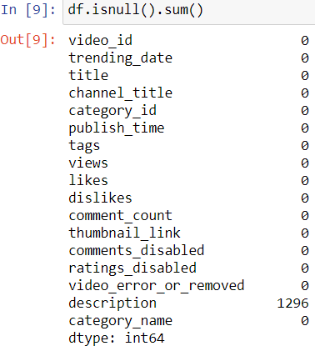
Missing data

Slide 5

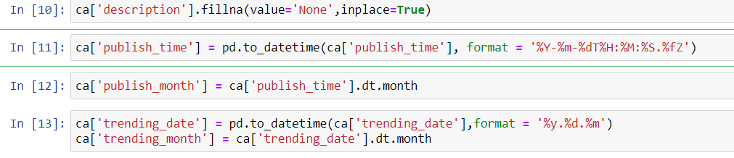
Formats of date and time

Slide 6

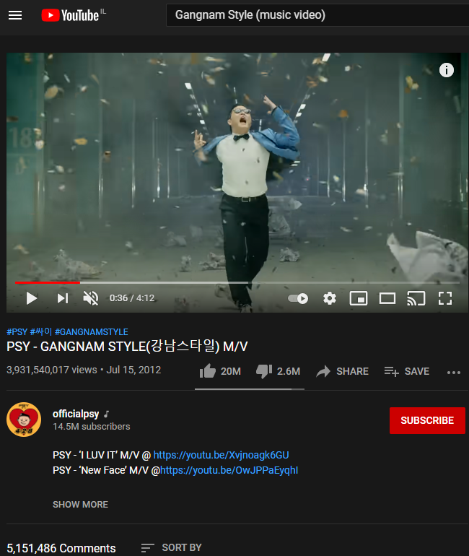


EDA
Gangnam Style:
First video over 1B views
Baby Shark:
Most viewed video today on YouTube.

Slide 7

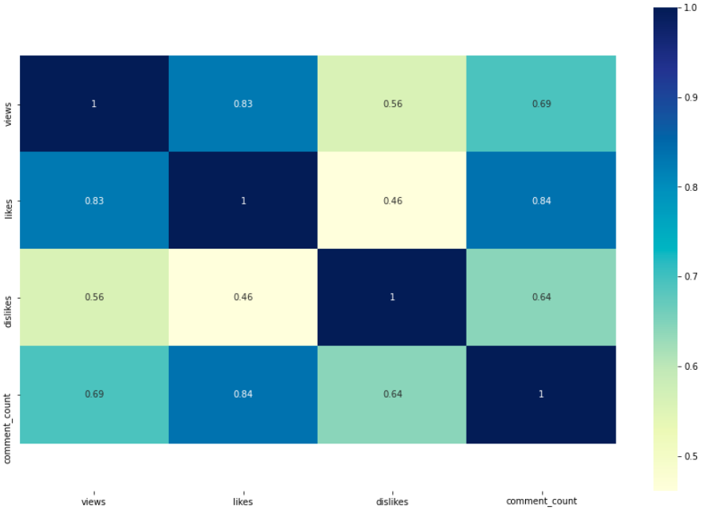
Most correlated parameters
Hight correlation:
+0.8
(likes:views) (likes:comment_count)
Medium correlation:
+0.6 (views:comment_count)

Slide 8
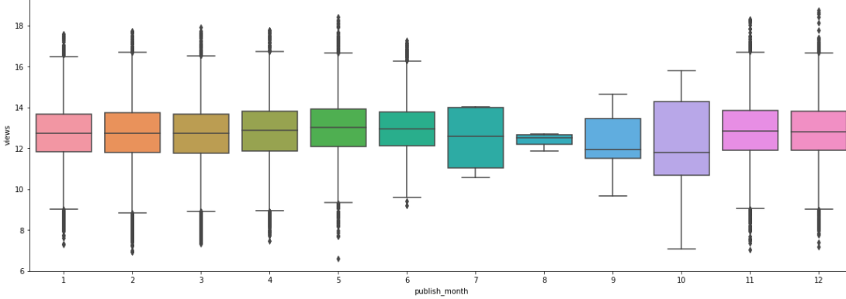
Marketing Funnel
Name: Boxplot that compares amount of views and month video published.
X-axis: publish month
Y-axis: views
Conclusion: there are more views on videos that published on August and October.
**compare between publish month and likes shows same results.

Slide 9
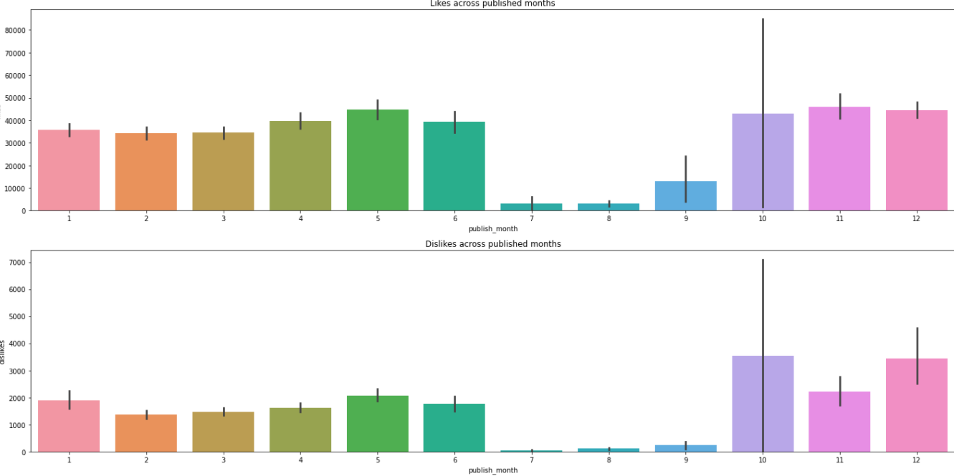
Amount of likes/dislikes by month
Name: Barplot that compares amount of likes/dislikes and month video published.
X-axis: publish month
Y-axis: likes/dislikes
Conclusion: easy to see that July, august and September have less activity in this compare.

Slide 10
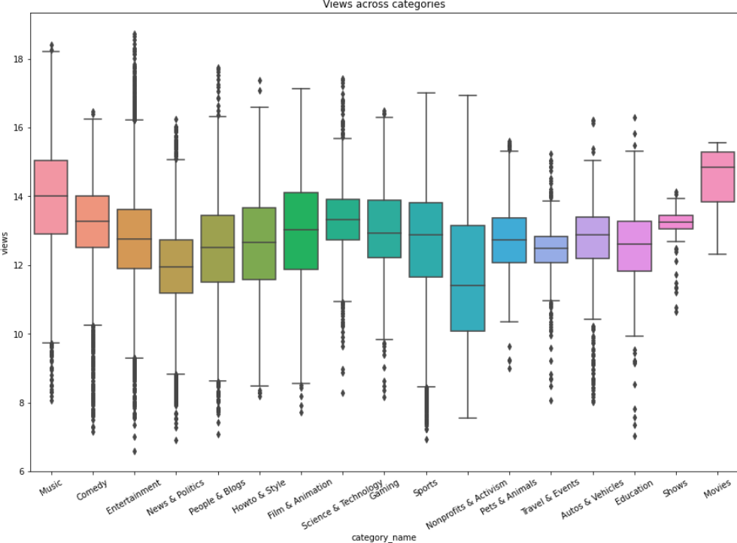
Amount of views per category
Name: Boxplot that compares amount of views and category of video.
X-axis: category
Y-axis: views
Conclusion: music and movies are most viewed videos on YouTube.

Slide 11


Positive & Negatives
Some of the positives of YouTube are:
Educational Value
Ability to display user created content
Some of the Negatives are:
Violence
Drugs

Slide 12
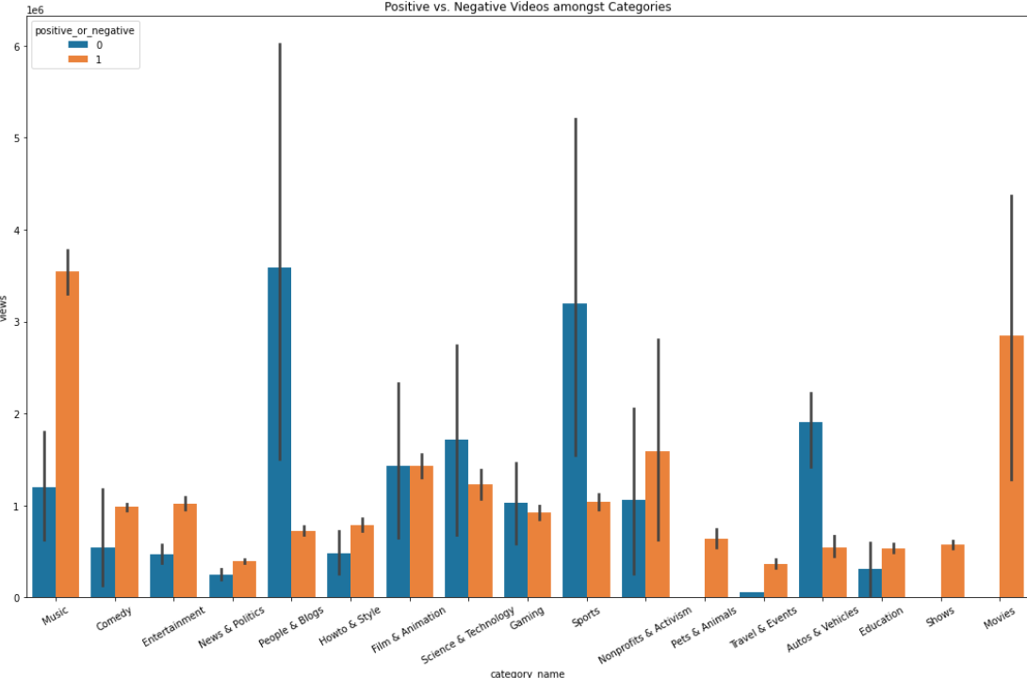
Positive or negative?
Name: Barplot that compares positive and negative amongst categories.
X-axis: category
Y-axis: views
Conclusion: music and movie are the most popular videos although the have a lot of negative issues.

Slide 13
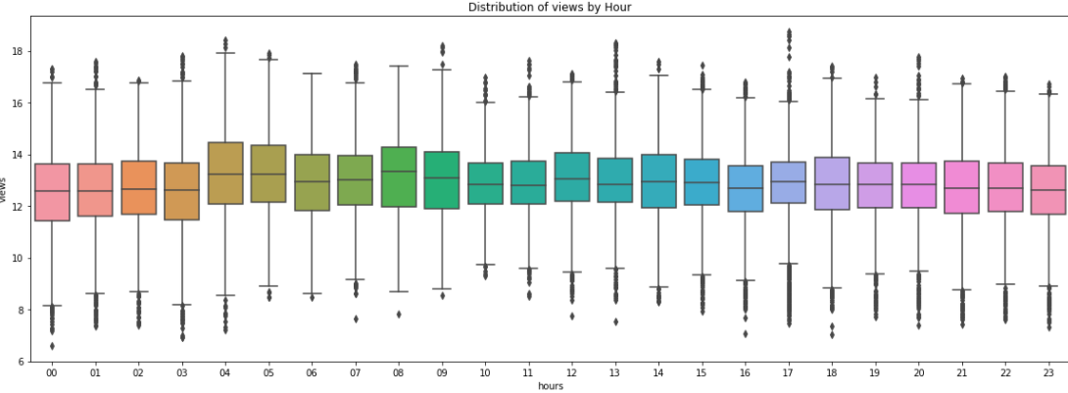
Time against popularity of video
Name: Boxplot that compares amount of views and hour video published.
X-axis: publish hour
Y-axis: views
Conclusion: not matter the hour of publishing the video.
**compare between publish month and likes shows same results.

Slide 14

Machine Learning
Of
Views

Slide 15


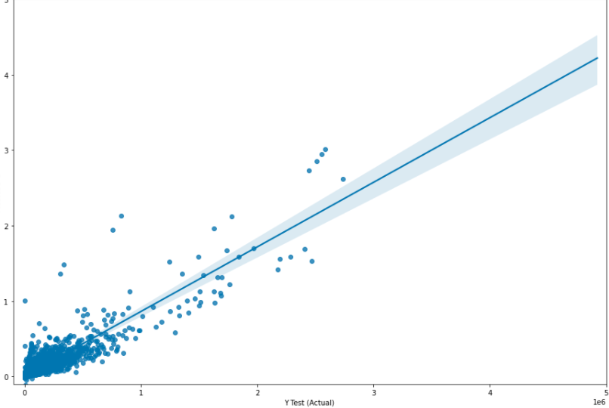
Linear regression
Using ‘sklearn’ library and liner regression we were able to train a model that predict the popularity/success of new uploaded video on YouTube.
The model predicted that if we will based on likes, views and comments our r^2 will be 0.839..

